Slide 1
#FunctionalElixir
GET FUNCTIONAL WITH ELIXIR

Slide 2
Trying to Learn for Seven Years

Slide 3
Maybe I’m Not Smart Enough

Slide 4
ELIXIR
Functional Programming for Everyone

Slide 5
Influenced by Ruby

Slide 6
Tried & True, Distributed Language

Slide 7
WHAT IS FUNCTIONAL PROGRAMMING?
Declarative Paradigm

Slide 8
What vs How

Slide 9
IMPERATIVE PARADIGM
var activeUsers = new List<User>();
for(var i = 0; i < users.length; i++){
if(users[i].isActive){
activeUsers.add(users[i]);
}
}

Slide 10
DECLARATIVE PARADIGM
Enum.filter(users, fn u -> u.is_active end)

Slide 11
DECLARATIVE PARADIGM
Enum.filter(users, fn u -> u.is_active end)

Slide 12
DECLARATIVE PARADIGM
Enum.filter(users, fn u -> u.is_active end)

Slide 13
DECLARATIVE PARADIGM
Enum.filter(users, fn u -> u.is_active end)

Slide 14
DECLARATIVE PARADIGM
Enum.filter(users, fn u -> u.is_active end)

Slide 15
Declarative Paradigm
Functions as First Class Citizens

Slide 16
FIRST CLASS FUNCTIONS
is_active = fn u -> u.is_active end
Enum.filter(users, is_active)

Slide 17
Declarative Paradigm
Functions as First Class Citizens
Immutability

Slide 18
IMMUTABLE DATA
users = [%{is_active: true}, %{is_active: false}]
active_users = Enum.filter(users, is_active)
users = [%{is_active: true}, %{is_active: false}]
active_users = [%{is_active: true}]

Slide 19
HOW I WANT TO FILTER USERS
users.filter(is_active)
Enum.filter(users, is_active)

Slide 20
Declarative Paradigm
Functions as First Class Citizens
Immutability
What not How
Functions Have the Power
Data Doesn’t Change

Slide 21
Elixir Makes Functional Programming Accessible

Slide 22
Pipe Operator (|>)

Slide 23
Enum.filter(Enum.map(String.split(File.read!("tweets.txt"), ~r{\n}), &String.strip/1), fn x -> String.length(x) <= 140 end)

Slide 24
WHAT’S THIS CODE DOING?
Enum.filter(Enum.map(String.split(File.read!("tweets.txt"), ~r{\n}), &String.strip/1), fn x -> String.length(x) <= 140 end)
Read a file
Split the file on new lines
Trim all extra whitespace
Only get strings that are tweetable

Slide 25
path |> File.read! |> String.split(~r{\n}) |> Enum.map(&String.trim/1) |> Enum.filter(fn x -> String.length(x) <= 140 end)

Slide 26
DEBUGGING WITH |>
my_list = [[1], [2,3], [4,5,6]]
my_list
|> Enum.at(1)
|> Enum.at(0)

Slide 27
DEBUGGING WITH |>
my_list = [[1], [2,3], [4,5,6]]
my_list
|> Enum.at(1)
|> IO.inspect #[2,3]
|> Enum.at(0)

Slide 28
What Not How: Tweetable Strings

Slide 29
FUNCTIONS HAVE POWER: COMPOSITION
def get_contents(path) do
path
|> File.read!
|> String.split(~r{\n})
|> Enum.map(&String.strip/1)
|> Enum.filter(fn x -> String.length(x) <= 140 end)
end

Slide 30
Pattern Matching

Slide 31
{first, last} = {“Nate”, “Taylor”} first: “Nate” last: “Taylor”

Slide 32
{first, “Taylor”} = {“Nate”, “Taylor”} first: “Nate”

Slide 33
{first, “Taylor”} = {“Nate”, “Diaz”}
** (MatchError) no match of right hand side value: {"Nate", ”Diaz"}

Slide 34
Pattern Matching: Return Values

Slide 35
case File.read(filename) do {:ok, file} -> IO.puts(file) {:error, reason} -> IO.puts(reason) end

Slide 36
Pattern Matching: Structs

Slide 37
def special_event(date) do case date do {10, 31, 1517} -> :reformation {10, 31, _} -> :halloween {10, 12, _} -> :my_birthday {1, 1, _} -> :new_years {_, 1, _} -> :first_of_the_month {_, _, 2000} -> :y2k _ -> :boring end end

Slide 38
Pattern Matching: Function Parameters

Slide 39
def is_dynamic(:c), do: :false def is_dynamic(:elixir), do: :true def is_dynamic(_other), do: :unknown

Slide 40
is_dynamic
is_dynamic(:javascript)
is_dynamic(:elixir)
is_dynamic(:c)
is_dynamic(_other)
:unknown

Slide 41
is_dynamic
is_dynamic(:c)
is_dynamic(:elixir)
is_dynamic(:c)
is_dynamic(_other)
:false

Slide 42
Pattern Matching: Recursion

Slide 43
def reverse(list) do reverse(list, []) end def reverse([], reversed), do: reversed def reverse([head | tail], reversed), do: reverse(tail, [head | reversed])

Slide 44
reverse
reverse([1,2,3])
reverse(list)
reverse([], reversed)
reverse([head | tail], reversed)
reverse([1,2,3], [])

Slide 45
reverse
reverse([1,2,3], [])
reverse(list)
reverse([], reversed)
reverse([head | tail], reversed)
reverse([1 | 2,3], [])
reverse([2,3], [1 | []])

Slide 46
reverse
reverse([2,3], [1])
reverse(list)
reverse([], reversed)
reverse([head | tail], reversed)
reverse([2 | 3], [1])
reverse([3], [2 | [1]])

Slide 47
reverse
reverse([3], [2, 1])
reverse(list)
reverse([], reversed)
reverse([head | tail], reversed)
reverse([3 | []], [2, 1])
reverse([], [3 | [2, 1]])

Slide 48
reverse
reverse([], [3, 2, 1])
reverse(list)
reverse([], reversed)
reverse([head | tail], reversed)
[3,2,1]

Slide 49
Elixir Makes Recursion Accessible

Slide 50
Demo: Power of Immutability

Slide 51
GetFunctionalFlow.benchmark( &GetFunctionalFlow.stream_count/0)

Slide 52
Arity
The number of parameters a function takes

Slide 53
ELIXIR PROCESSES

Slide 54
ELIXIR PROCESSES

Slide 55
ELIXIR PROCESSES

Slide 56
FLOW CODE
“In the beginning, God created the…”
In
the
beginning
God
created
the
In
the
beginning
God
created
∑
∑
∑
∑
∑

Slide 57
How Do I Get Started?

Slide 58
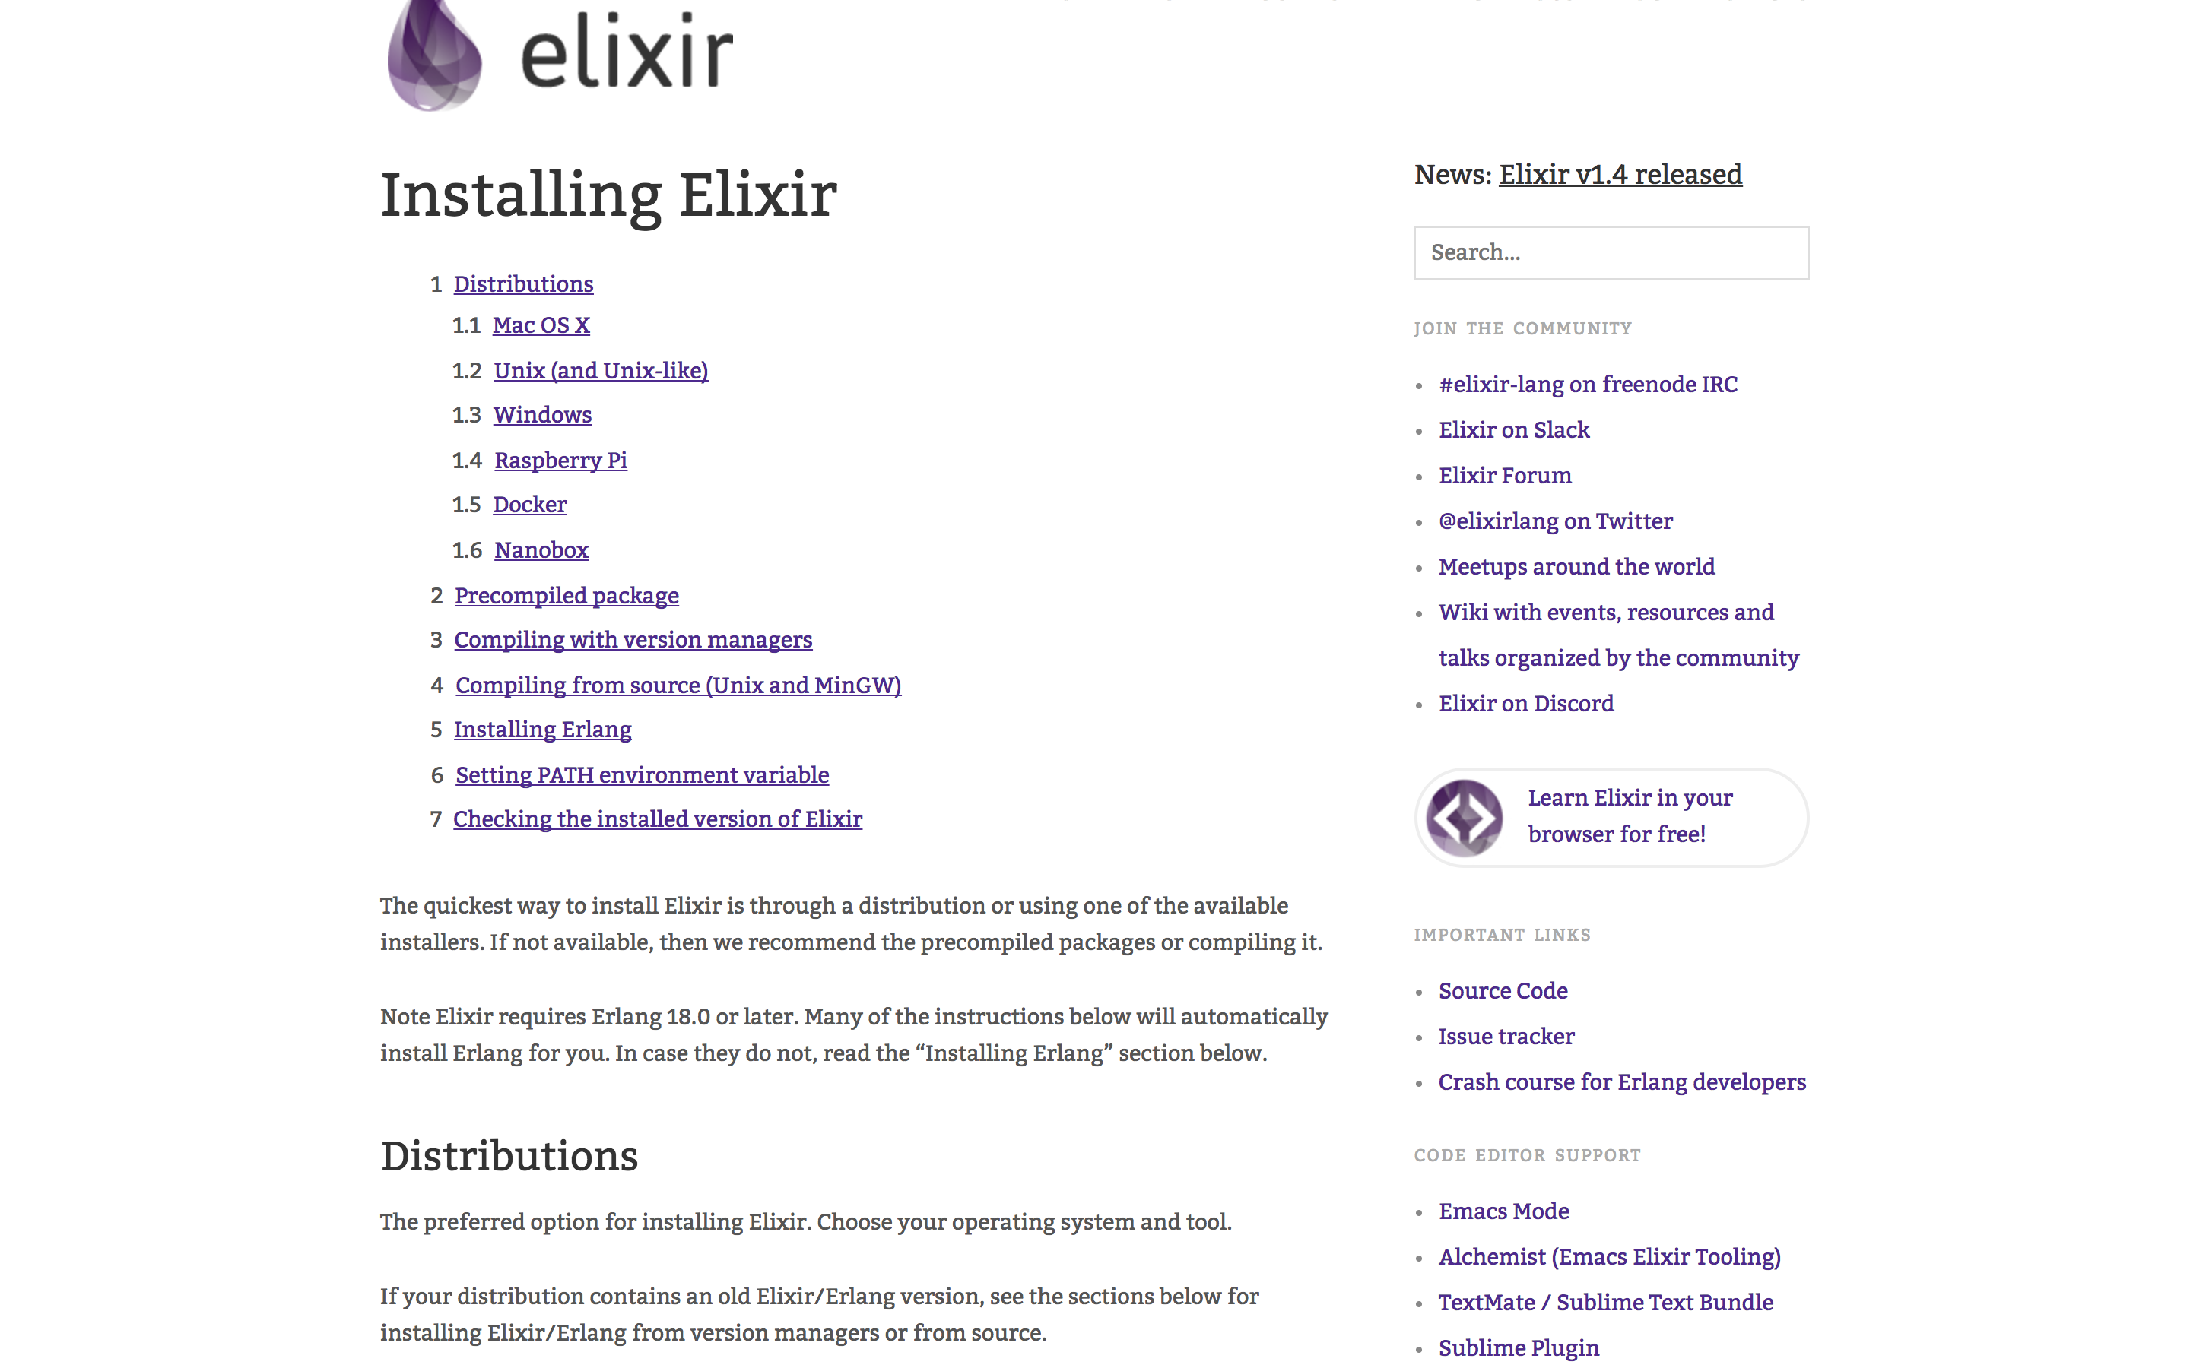
INSTALLING ELIXIR

Slide 59


BLATANT SELF PROMOTION

Slide 60
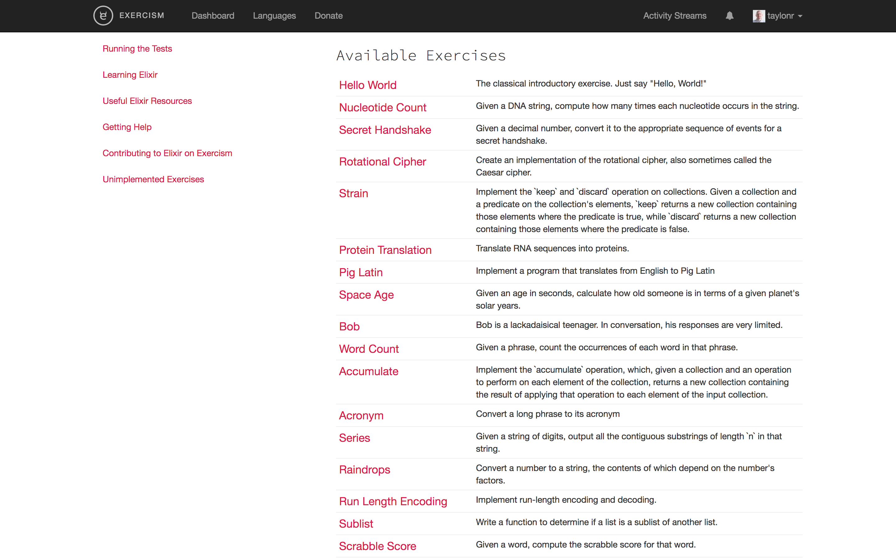
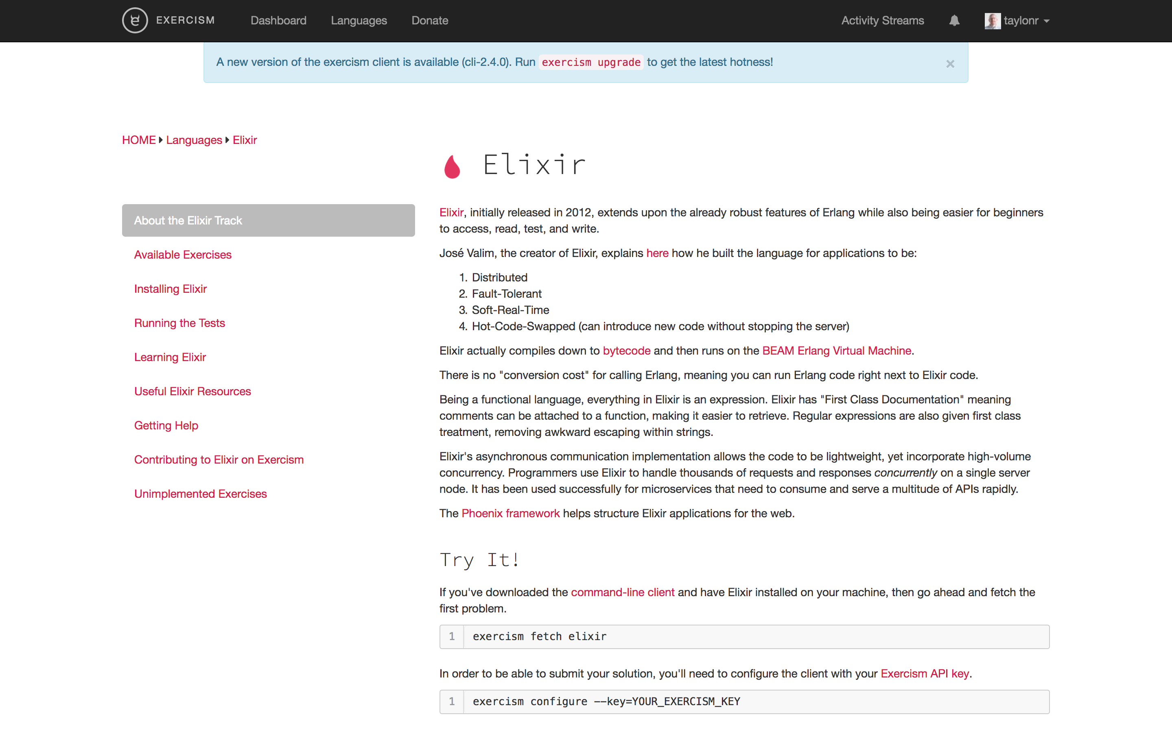
EXERCISM.IO

Slide 61
DEMYSTIFYING FUNCTIONAL PROGRAMMING
What not How
Functions Have the Power
Data Doesn’t Change

Slide 62
Elixir Makes Functional Programming Accessible

